Slide 1
Employee Data Analysis using Excel
STUDENT NAME: Janani. B
REGISTER NO:A51304C197A87E3AB684B1C4531D1C4C
DEPARTMENT: Commerce
COLLEGE: Bharathi Women's college

Slide 2
PROJECT TITLE
EMPLOYEE SALARY ANALYSIS

Slide 3


AGENDA
Problem Statement
Project Overview
End Users
Our Solution and Proposition
Dataset Description
Modelling Approach
Results and Discussion
Conclusion
3/21/2024 Annual Review

Slide 4

PROBLEM STATEMENT
The analysis will focus on internal equity, potential pay gaps, and factors impacting salary levels, as well as comparisons to industry benchmarks. The goal is to develop recommendations for salary adjustments, promotions, or policy changes to maintain a fair, competitive, and equitable compensation system.

Slide 5

PROJECT OVERVIEW
An Employee Salary Analysis project involves collecting and analyzing salary data to assess compensation trends, fairness, and competitiveness. The analysis includes comparing salaries within the organization and against industry benchmarks, identifying trends like pay gaps, and evaluating budget allocation. The goal is to recommend adjustments for equitable and competitive pay practices.

Slide 6

WHO ARE THE END USERS?
The end users of an Employee Salary Analysis project include various stakeholders within and outside the organization. The HR department uses the analysis to implement fair and competitive compensation strategies, while management and executives rely on it to make informed decisions regarding salary budgets and adjustments. The finance team ensures that salary expenses align with the company’s overall financial plans. Indirectly, employees benefit from fair pay policies and potential salary adjustments. Additionally, external auditors and regulators may use the data to verify compliance with labor laws and pay equity standards.

Slide 7

OUR SOLUTION AND ITS VALUE PROPOSITION
Our solution provides a comprehensive salary analysis tool that helps organizations assess and optimize their compensation structures. By offering insights into salary trends, pay gaps, and industry benchmarks, it ensures fair and competitive compensation practices

Slide 8
Dataset Description
A dataset description provides an overview of the data used for analysis. It typically includes details such as the number of records (employees), the variables or columns (e.g., salary, bonuses, job roles, departments, experience, and location), and the format or types of data (e.g., numerical or categorical). This description helps users understand the scope and structure of the data, facilitating accurate analysis and interpretation.

Slide 9

THE "WOW" IN OUR SOLUTION
The "wow" factor in our Employee Salary Analysis solution lies in its ability to provide deep, actionable insights into salary structures with minimal effort. It not only identifies pay gaps and ensures equitable compensation but also benchmarks salaries against industry standards in real-time.
3/21/2024 Annual Review
9

Slide 10
MODELLING
An Introduction to Project Modeling and Planning (Springer Texts in Business and Economics) Offers a comprehensive introduction to project management, focusing on project planning and control, with an emphasis on mathematical modeling Highlights theoretical concepts and models with detailed explanations, application examples and case studies based on real life problems Includes exercises at the end of each chapter, as well as PowerPoint slides for in-class lectures or as a guide for self-study
10

Slide 11
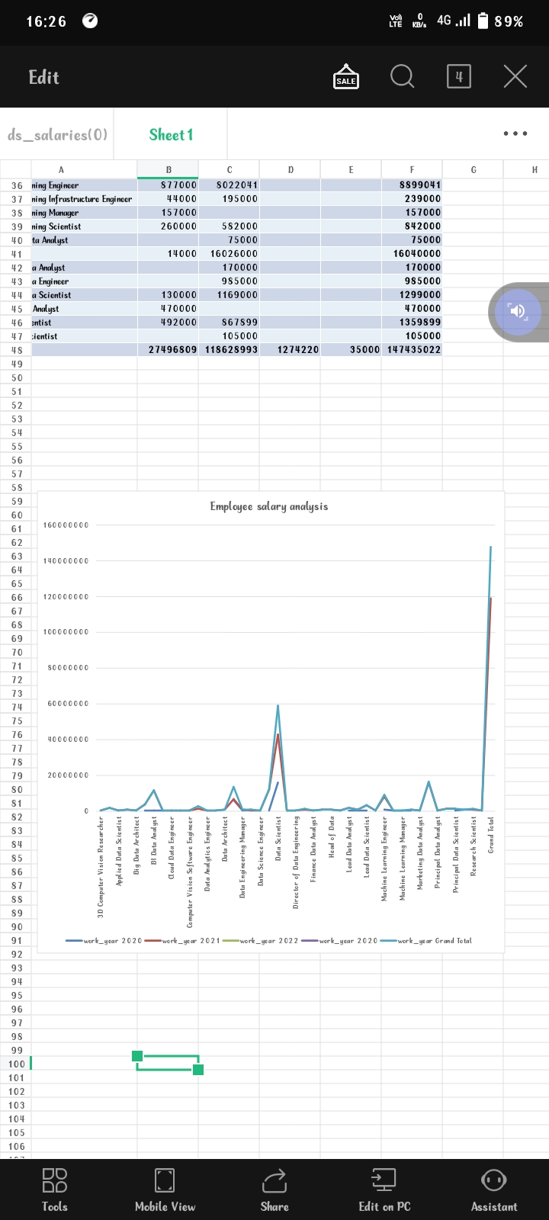
RESULTS
11

Slide 12
conclusion
Skill development programs These programs can help develop a skilled workforce, reduce youth unemployment, and promote economic growth. Organizational justice This is how an employee perceives and judges their employer's treatment in terms of fairness and justice.

